Slide 1
Pointers & DMA

Slide 2
Pointer to function
int main(){
int a=10;
inc (&a);
printf(“\n %d”, a);
return 0;
}
void inc(int *a){
*a= *a * 10;
}

Slide 3
Pointer to a Pointer
int x = 42;
int *p = &x;
int **q = &p;
int main(){
int *p, **q, a=10;
p=&a;
q=&p;
printf("\n address = %d value =%d", q, *p);
}

Slide 4
Pointer to array
int arr[] = {1, 2, 3};
int *p = arr; // p points to the first element of array
For( int i=0; i<3 ; i++)
printf("%d\n", *(p + i) ); // prints 2

Slide 5
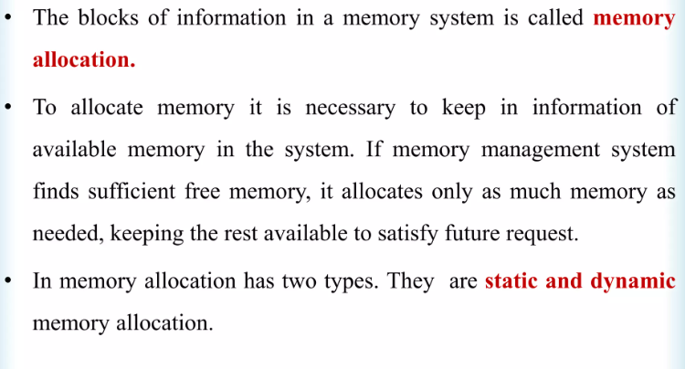
Memory Allocation

Slide 6
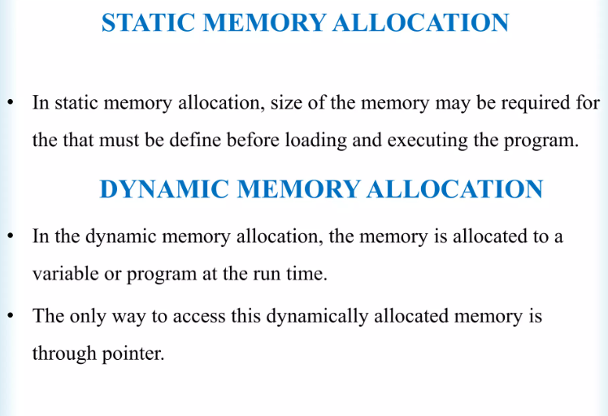

Slide 7
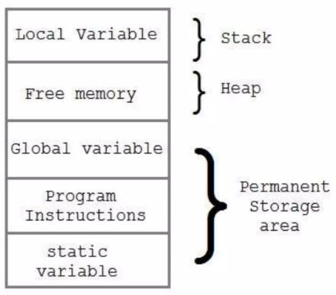
Memory Allocation Process

Slide 8
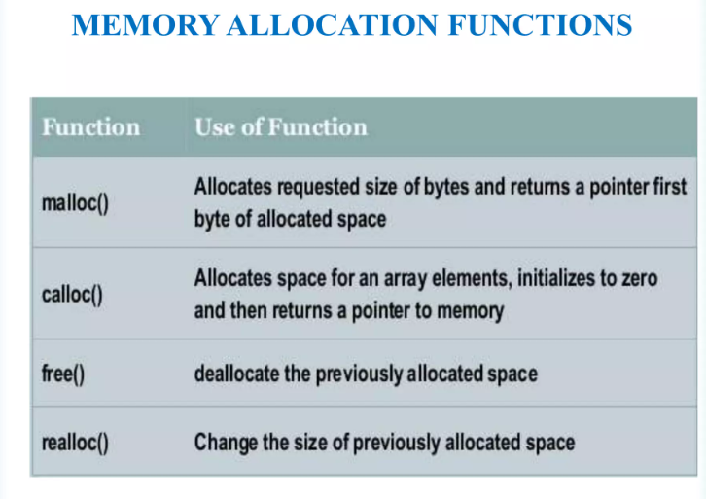
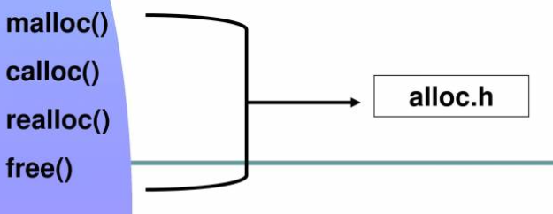

Slide 9
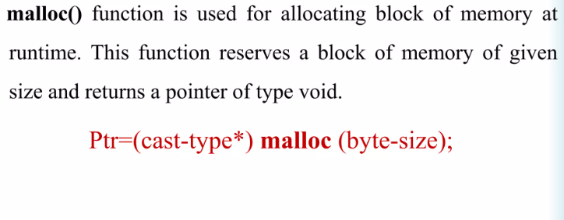

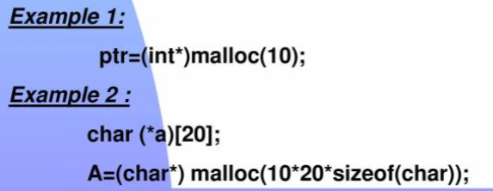
malloc()

Slide 10
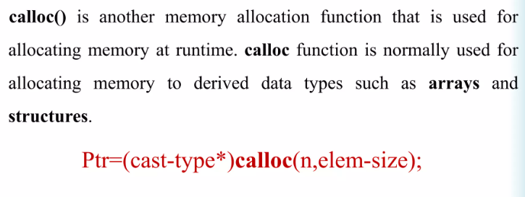
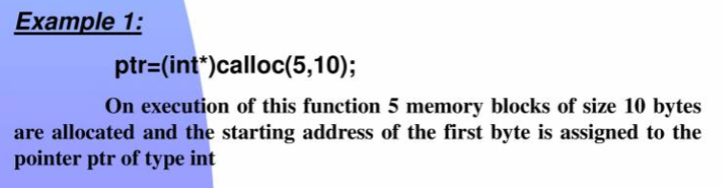
calloc()

Slide 11
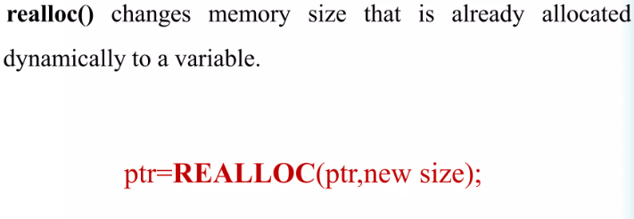
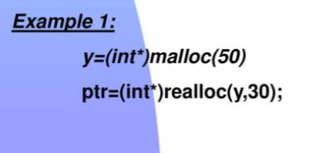
Altering the size

Slide 12
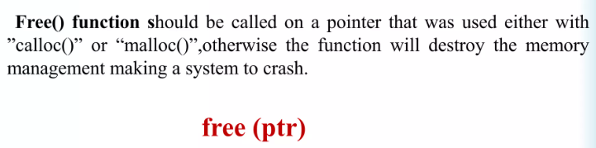
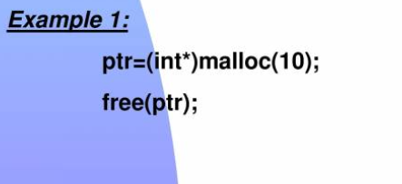
free()

Slide 13
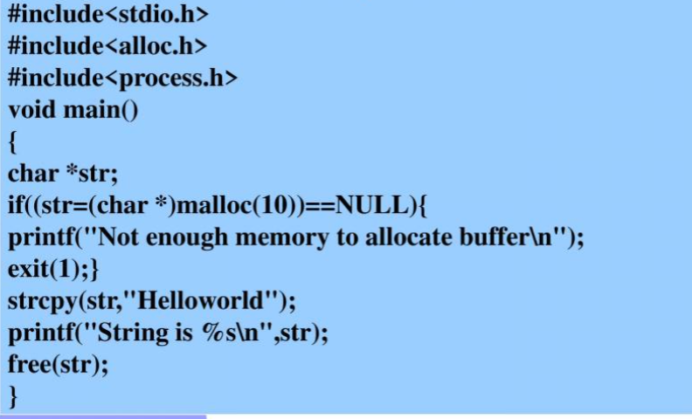
Examples malloc()

Slide 14
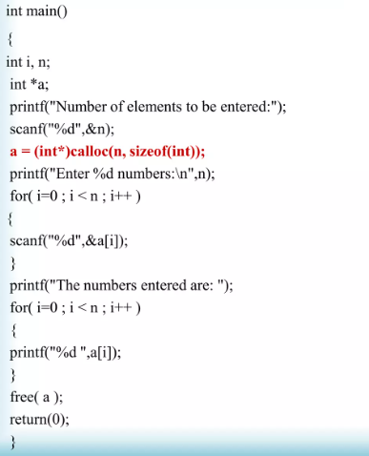
Example calloc()

Slide 15
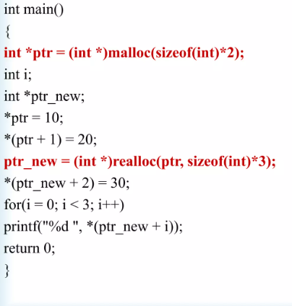
Example realloc()

Slide 16
void main(){
int *ptr, i, *start;
ptr= (int *) mallo (sizeof(int)*5);
start=ptr;
*ptr=10;
ptr++;
*ptr=20;
ptr++;
*ptr=30;
ptr++;
*ptr=40;
ptr++;
*ptr=50;
ptr++;
ptr=start;
for(i=0; i<5;i++){
printf("\n %d", *ptr);
ptr++;
}
free(ptr);
start=NULL;
ptr=NULL;;
}

